Slide 1
Prompt Engineering 101
Understanding the nature of working with LLMs

Slide 2
Understanding the nature of working with LLMs

Slide 3


Diego
Debo
GPT says… “Constantly looking for other challenges, he sees connections other miss” “Sleep? Ironically, he works at a sleep company but runs on caffeine and conviction”
“In 15 years, he`ll be Founder & CEO of LegacyOS – a LifeTech startup”
GPT says… “Breaks down complex problems into logical steps; thrives on clarity and structure” “Prefers working independently with minimal micromanagement”
“In 15 years, he`ll be CTO of Axiom Metrics, a DeepTech and Smart Manufacturing startup”

Slide 4
Agenda
1. What & Whys
2. LLMs Purpose
3. Basic Prompting
4. Advanced Prompting
5. Hands-on Demo
6. Q&A

Slide 5

Live Attendance

Slide 6

Recording Attendance

Slide 7
What are LLMs

Slide 8
Large Language Models
Deep Learning Model trained to recognize patterns in massive amount of text
Artificial Intelligence → Machine Learning → Neural Networks → Deep Learning

Slide 9
Why LLMs

Slide 10
" AI Won't Replace Humans – But Humans With AI Will Replace Humans Without AI "
Harvard Business Review

Slide 11
What's In For Emma
Increased Productivity
Competitive Advantage
Data Utilization
Future-Proofing
Up to 40%
Twice as likely to be market leader
Better forecasting and trend analysis
More effective adaptation dynamic market conditions

Slide 12
What's In For Emmies
Higher Job Market Value
Career Advancement
Resilience to Job Displacement
Decisional Skills
100M new jobs by end of 2025 will require AI literacy
AI expertise leads to deeper career paths
Adaptability to changing job requirements
Improved problem-solving capabilities

Slide 13
Training Objective
Turn LLMs from generic tools to domain-specific copilots

Slide 14
LLMs Purpose

Slide 15




Application Clusters
Text Generation
Sentiment Analysis
Deep Research
(Image Generation)

Slide 16


Text Generation
Email Writing & Replies
SEO-Optimized Content
Ad Headlines
Product Descriptions
Script Writing for Videos
Meeting Notes & Summaries

Slide 17


Sentiment Analysis
Brand Reputation Management
Competitor Benchmarking
Content Moderation
Social Media Listening
Employee Engagement Surveys
Review Analytics

Slide 18



Language Intelligence
Enable Cross-Lingual Meetings
Marketing Content Repurposing
Multilingual Chatbots & VA
Enable Worldwide Content Distribution

Slide 19


Deep Research
Document Summarization
Semantic Search and Retrieval
Due Diligence and Risk Research
Comparative Research and Benchmarking
Trend Detection
Regulatory Analysis

Slide 20

Image Generation
Marketing Visuals & Campaign Assets
Interior Designs
Logo Explorations
Product Mockups
Storyboarding & Concept Art
Social Media Content

Slide 21

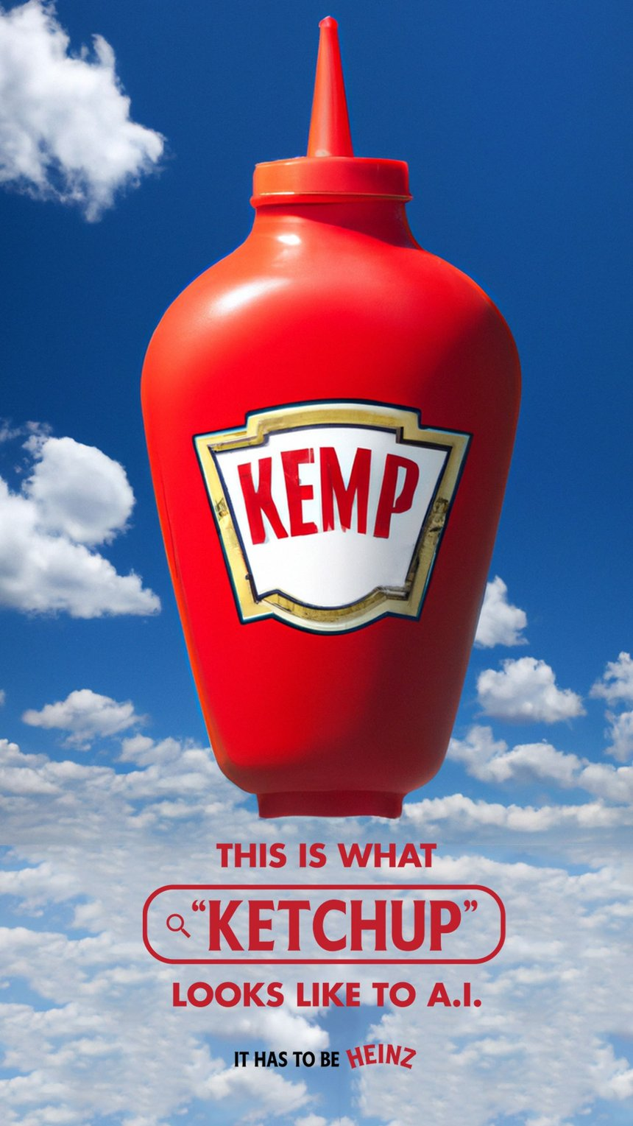
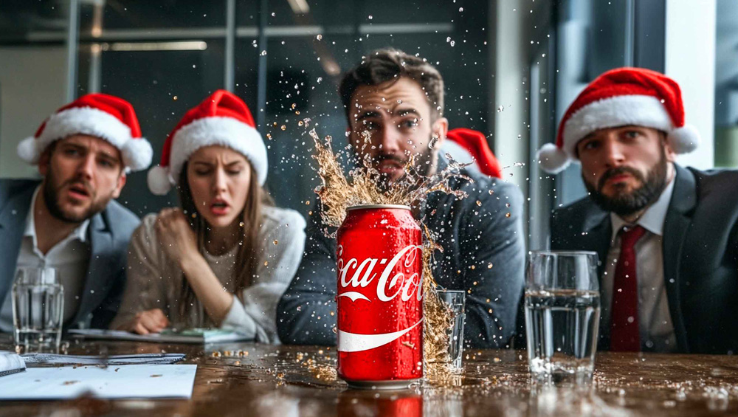

Slide 22



Slide 23
Meaning of Prompting
Prompting ≈ Programming the LLM
Clear, Specific, Goal Oriented Instruction that guide the model to a useful output

Slide 24
The Role of Tokens
LLMs Process Words Tokens
I Love Emma. = 3 Words (I, Love, Emma) – 4 Tokens (I, Love, Emma, . )
Token Limits
Costs Implications
LLM Effectiveness = Accuracy Of Predicting The Next Token

Slide 25
“NOT ALL LLMs Are Created Equally and Are Best Suited for Specific Tasks.”
Copilot, 2025

Slide 26






Different LLMs for Different Scopes

Slide 27
The Quality Of The Prompt Determines The Quality Of The LLM Response

Slide 28
Prompting Basics

Slide 29
Rule nr. 1
Clarity + Simplicity + Constraints
(Clear ≠ Short)

Slide 30
Clear ≠ Short
“ Mattress AirGrid Technology “
vs
“ Summarize the key advantages of AirGrid Technology in a hybrid Emma Mattress within 300 words. Think step by step “

Slide 31

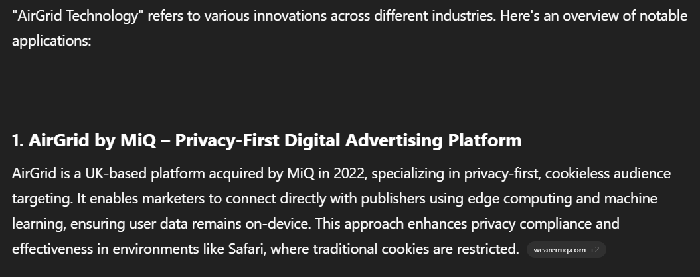

Slide 32
Rule nr. 2
Role + Context + Examples
Write the USPs paragraph of the Emma One vs You are a business developer working at Emma, with the task to write the USPs paragraph of the Emma One Matratze. Take as example the style of the USPs written for the Emma Classic 25 Flip Matratze (Link to PDP)

Slide 33
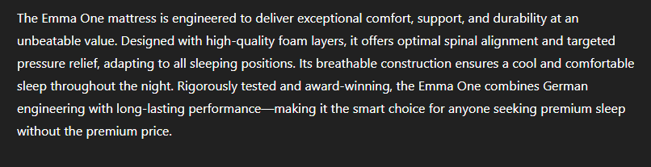
Write the USPs paragraph of the Emma One

Slide 34
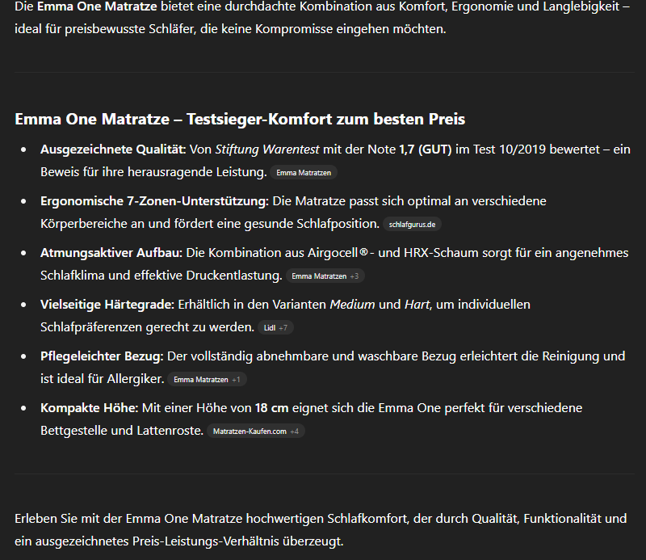
You are a business developer working at Emma, with the task to write the USPs paragraph of the Emma One Matratze. Take as example the style of the USPs written for the Emma Classic 25 Flip Matratze (Link to PDP)

Slide 35
Rule nr. 3
Expectations Setting
Create an overview of the major competitors of Emma Sleep in Germany vs Create an overview of the major competitors of Emma Sleep in Germany. Expectation: sorted data table (by annual revenues)

Slide 36
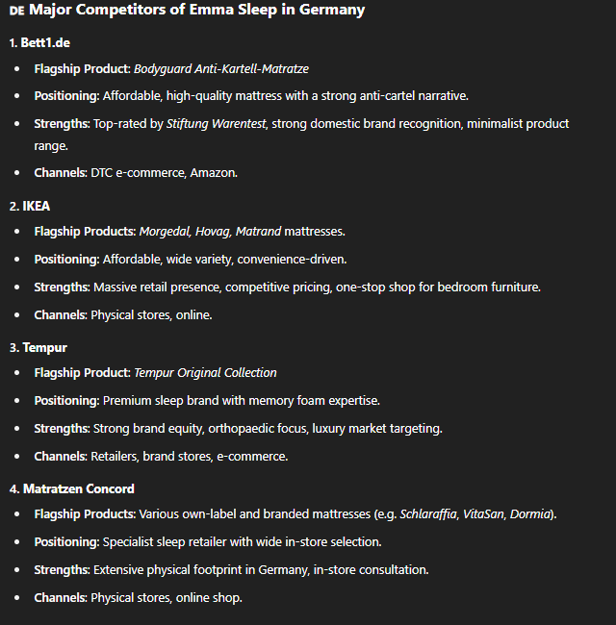
Create an overview of the major competitors of Emma Sleep in Germany

Slide 37
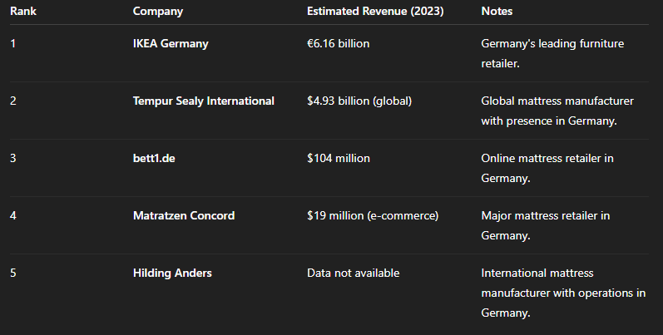
Create an overview of the major competitors of Emma Sleep in Germany. Expectation: sorted data table (by annual revenues)

Slide 38
Rule nr. 4
Tone Setting
You are the CFO of a Startup, that needs to communicate to its employees the closing of a funding round. Write an Email. vs You are the CFO of a Startup, that needs to communicate to its employees the closing of a funding round. Write an Email. Tone: Business Formal

Slide 39
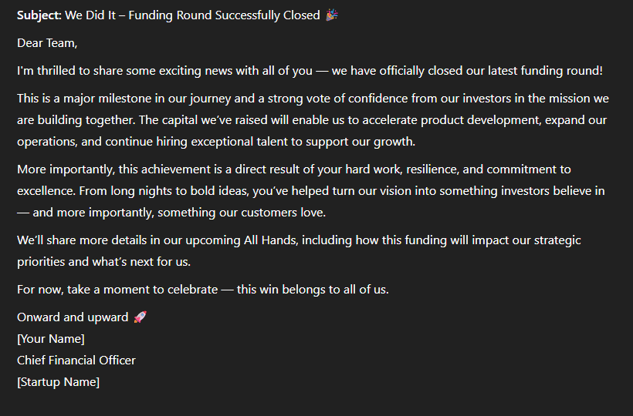
You are the CFO of a Startup, that needs to communicate to its employees the closing of a funding round. Write an Email.

Slide 40
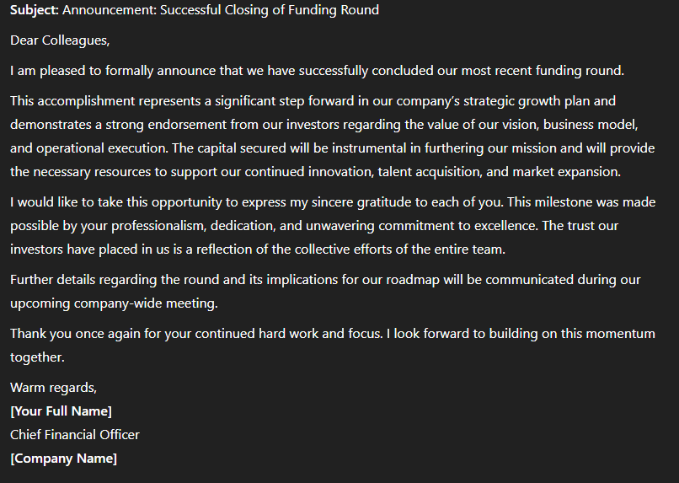
You are the CFO of a Startup, that needs to communicate to its employees the closing of a funding round. Write an Email. Tone: Business Formal

Slide 41
Best Practices
Be Mindful of Limitations
Avoid Vague Prompts
Verify Outputs for Accuracy

Slide 42
Advanced Prompting

Slide 43
Temperature Prompting
Manipulate the randomness and creativity of the LLM by adjusting the temperature on a scale of [0.0 to 1.5]

Slide 44
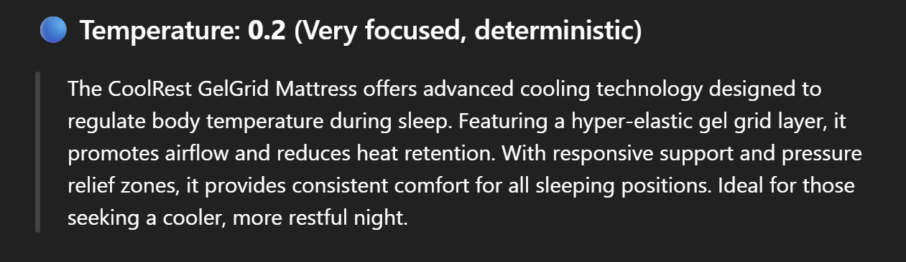
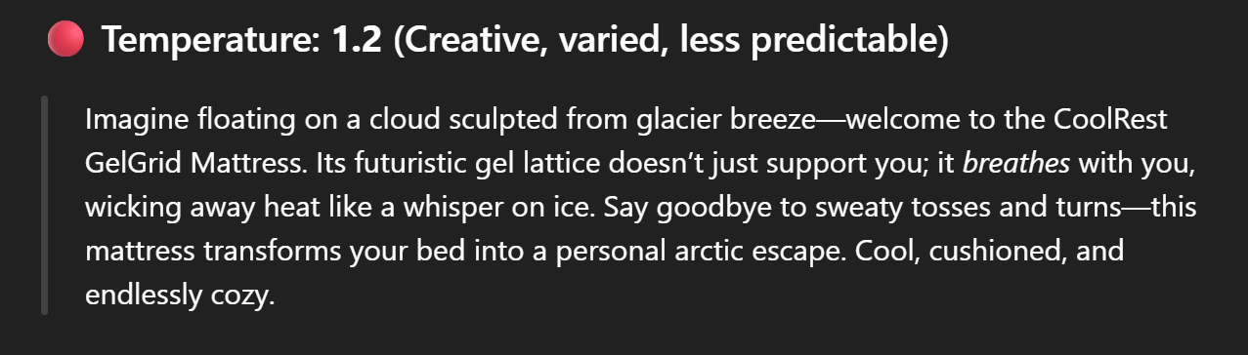
Temperature Prompting

Slide 45
Deep Research
Unsupervised learning aimed at hidden patterns and nuanced understandings

Slide 46
Meta Prompting
Write prompts that help the model optimize its prompts

Slide 47
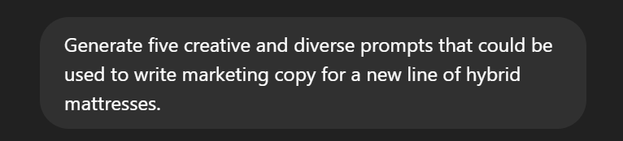
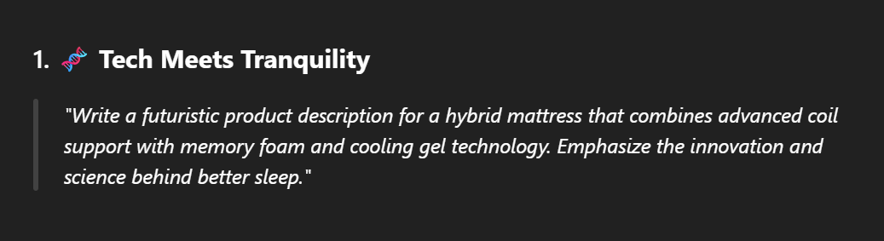
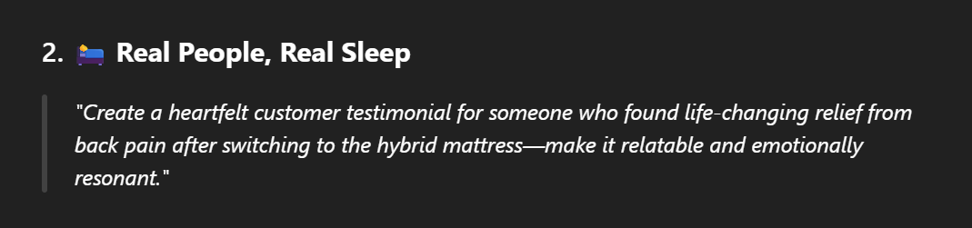
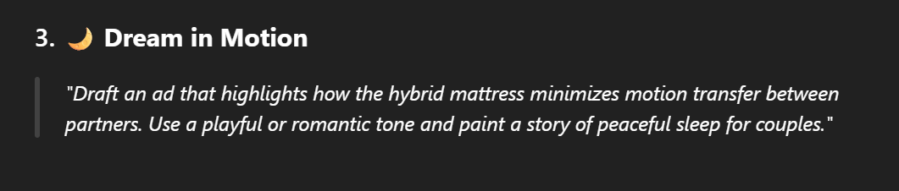
Meta Prompting

Slide 48
Hands-on Demo
Aiforwork.co

Slide 49
Q&A Session

Slide 50
Thanks for joining!

